Slide 1


IS 669 - Big Data Analytics Project
Analysing Airlines Arrival and Departure delay
Fall 2022
Team Red
Red Team
Prerna Deolekar | Ramya Dhabade | Krina Gandhi | Himanshu Hariyani | Shubham Kadam

Slide 2
Team Members & Years Assigned:
01
Prerna Deolekar
1988
02
Nandu Devarasetty
Ramya Dhabade
1993
03
Krina Gandhi
1998
04
Himanshu Hariyani
2003
05
Shubham Kadam
2008

Slide 3

Prerna Deolekar

Slide 4
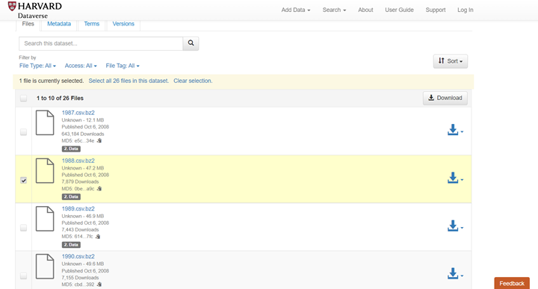
Data Source
Airline On Time Data
The data represents flight arrival and departure details for all commercial flights within the USA for the year 1988
Prerna Deolekar - Year 1988

Slide 5
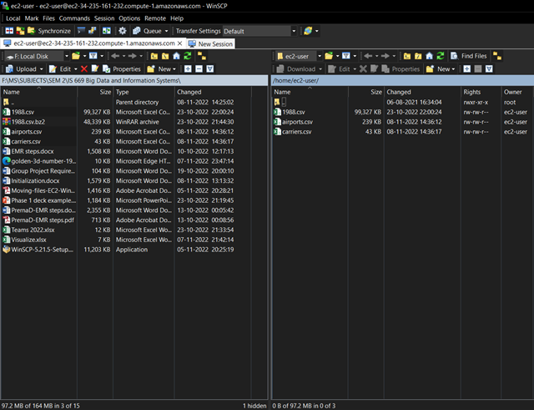
File Transfer
WINSCP used for uploading file to EMR server
Prerna Deolekar - Year 1988

Slide 6
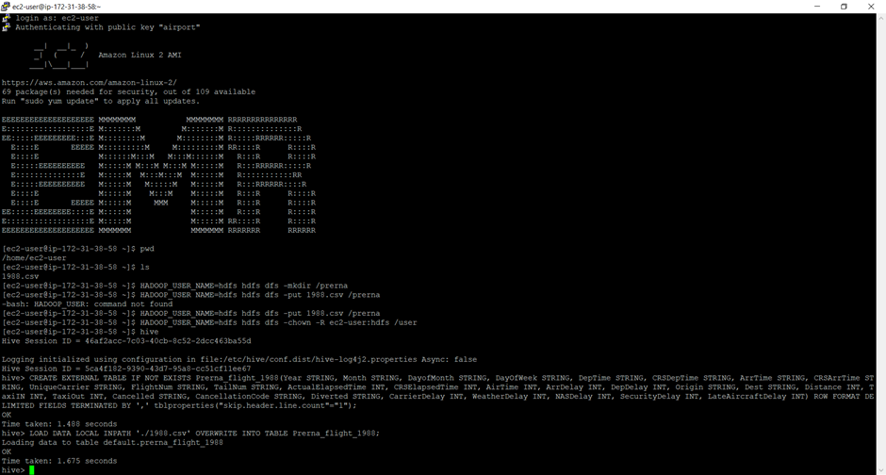
Creation of table in putty
Prerna Deolekar - Year 1988

Slide 7
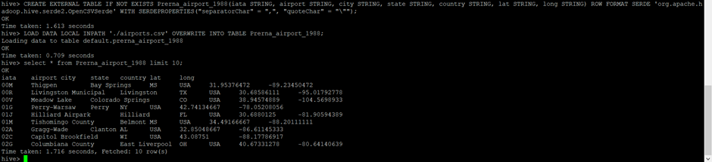
Displaying airport dataset
Prerna Deolekar - Year 1988

Slide 8
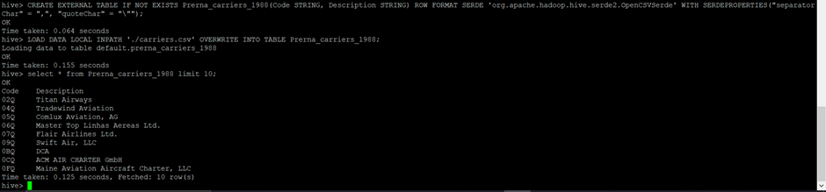
Displaying carrier dataset
Prerna Deolekar - Year 1988

Slide 9
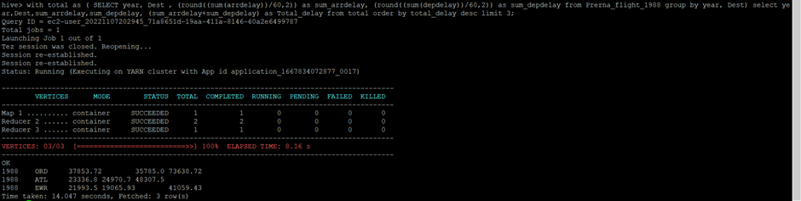
CASE 1
Determining three airports with highest delay time (in hours) for year 1988
Prerna Deolekar - Year 1988

Slide 10
CASE 1: RESULT
The three airports with the highest delay time (in hours)
Year | Airport Code | Airport Name | Arrival time Delay (in hours) | Departure time Delay (in hours) | Total Delay (in hours)
1988 | ORD | O'Hare International Airport, Chicago | 37853.72 | 35785.0 | 73638.72
1988 | ATL | Hartsfield-Jackson Atlanta Airport | 23336.8 | 24970.7 | 48307.5
1988 | EWR | Newark Liberty International Airport | 21993.5 | 19065.93 | 41059.43
Prerna Deolekar - Year 1988

Slide 11
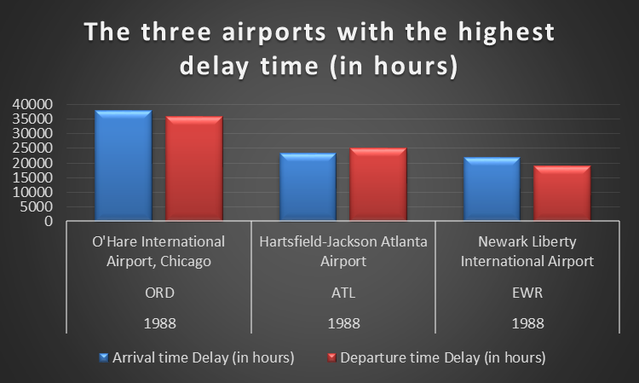
Prerna Deolekar - Year 1988

Slide 12
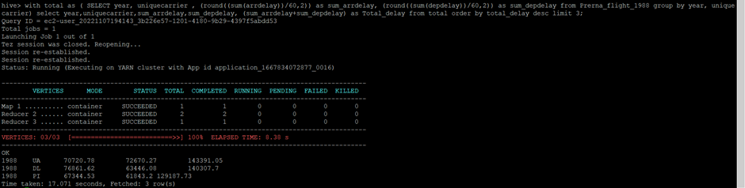
CASE 2
Determining three carriers with highest delay time (in hours) for year 1988
Prerna Deolekar - Year 1988

Slide 13
CASE 2: RESULT
The three carriers with the highest delay time (in hours)
Year | Carrier Code | Carrier | Arrival time Delay (in hours) | Departure time Delay (in hours) | Total Delay (in hours)
1988 | UA | United Airlines | 70720.78 | 72670.27 | 143391.05
1988 | DL | Delta Airlines | 76861.62 | 63446.08 | 140307.7
1988 | PI | Polar Airlines | 67344.53 | 61843.2 | 129387.73
Prerna Deolekar - Year 1988

Slide 14
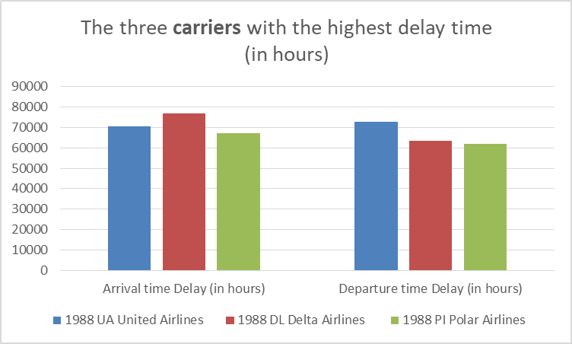
Prerna Deolekar - Year 1988

Slide 15

CASE 3
Overall Departure delays for year 1988
Prerna Deolekar - Year 1988

Slide 16

CASE 3 (contd.)
Overall Arrival delays for year 1988
Prerna Deolekar - Year 1988

Slide 17
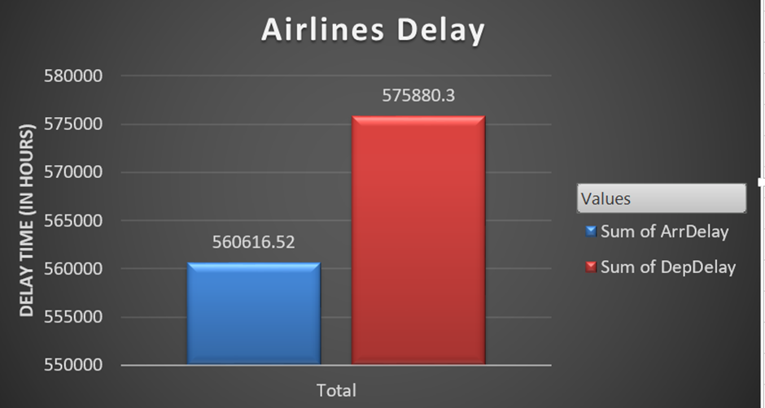
CASE 3: RESULT
Overall Arrival was the smallest contributor for the year 1988
Prerna Deolekar - Year 1988

Slide 18

Ramya Dhabade

Slide 19
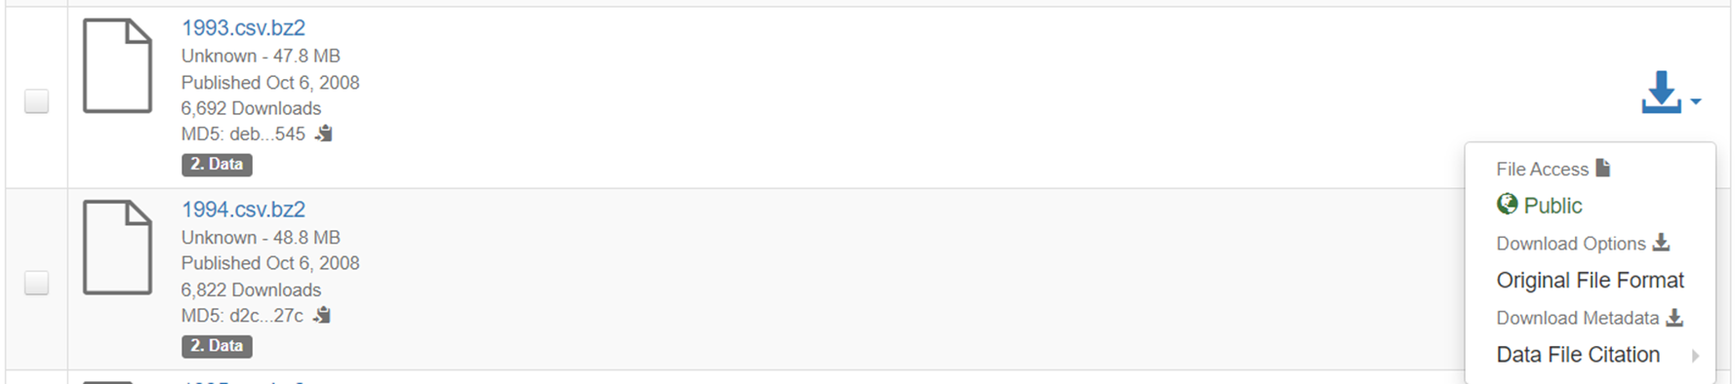
Airline On Time Data
The data represents flight arrival and departure details for all commercial flights within the USA for the year 1993
Ramya Dhabade - Year 1993

Slide 20
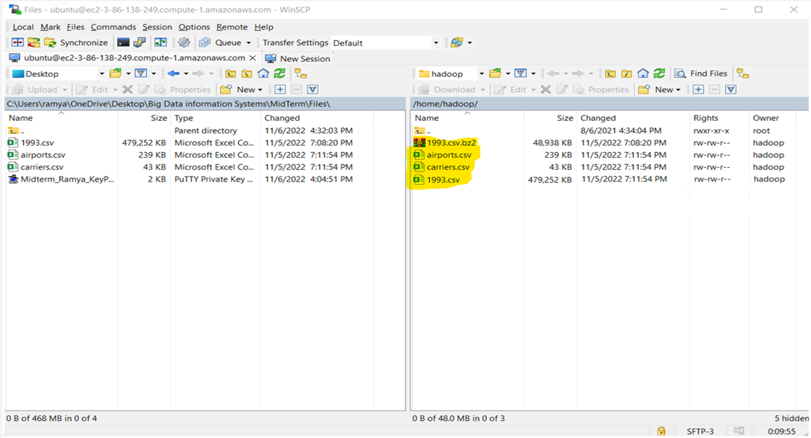
FILE TRANSFER
WINSCP used for upload of file to the EMR server
Ramya Dhabade - Year 1993

Slide 21
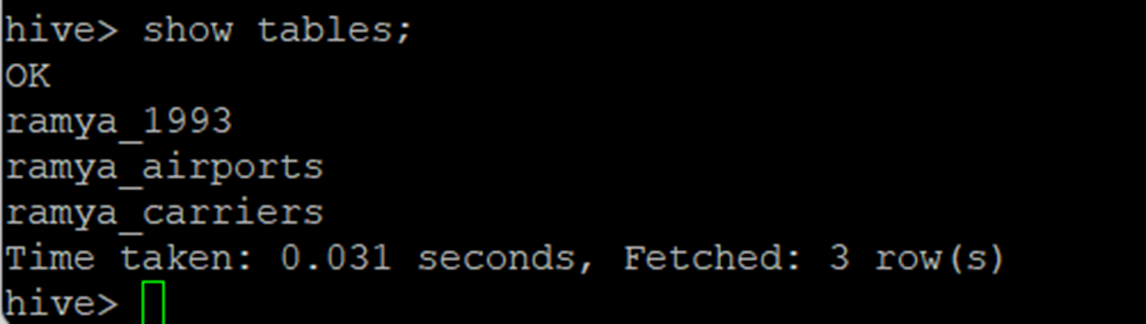
Created a Hadoop table and loaded all the file data into it.
Prefixed the table name with first name.
Show Tables
Ramya Dhabade - Year 1993

Slide 22
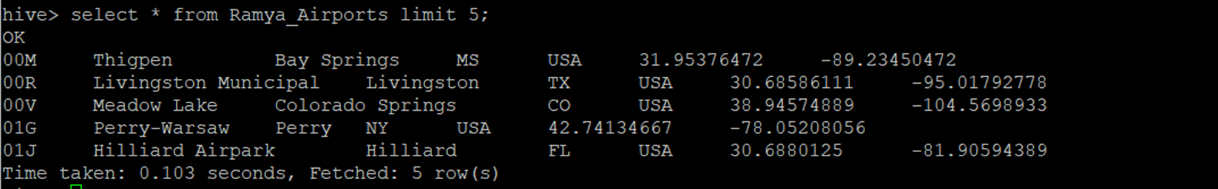
Sample of the loaded rows from the table Ramya_Airports
Ramya Dhabade - Year 1993

Slide 23
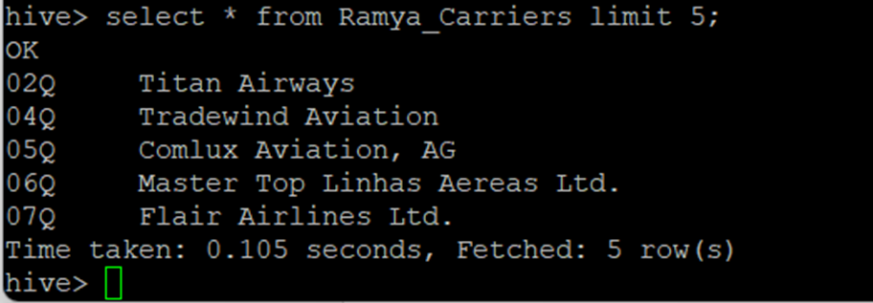
Sample of the loaded rows from table Ramya_Carriers.
Ramya Dhabade - Year 1993

Slide 24
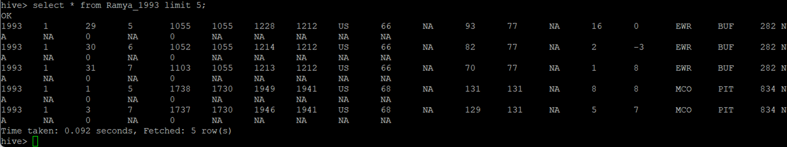
Sample of the loaded rows from table Ramya_1993
Ramya Dhabade - Year 1993

Slide 25
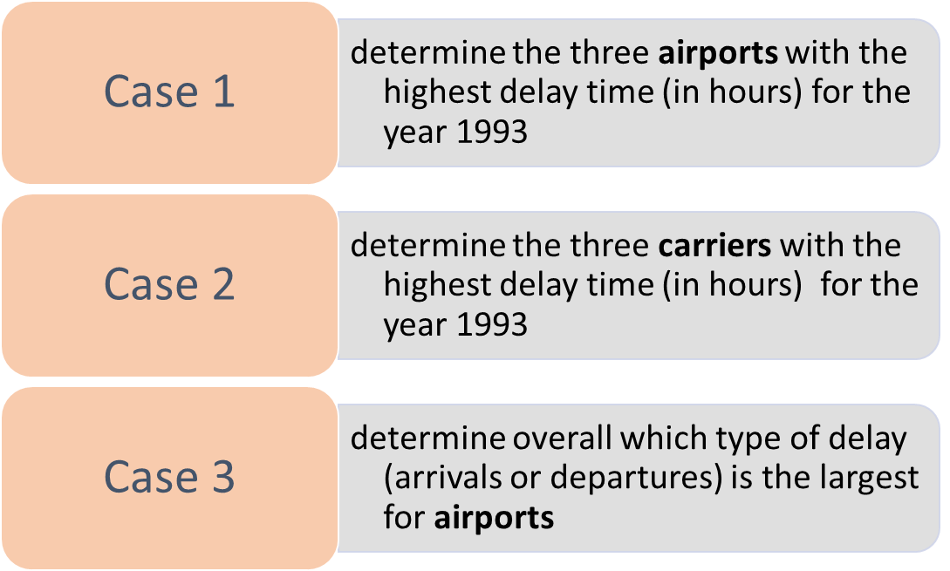
DATA ANALYSIS
Ramya Dhabade - Year 1993

Slide 26
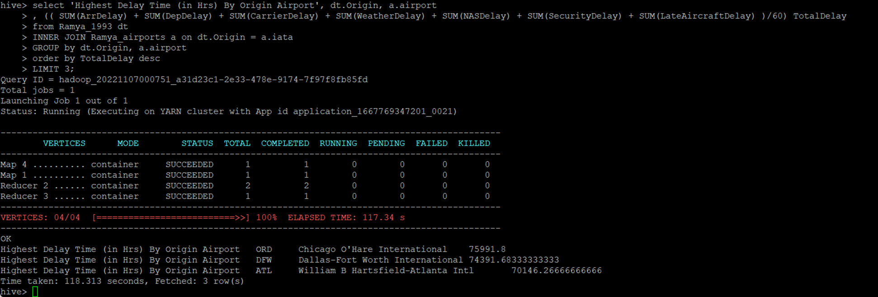
CASE 1
Determine the three airports with the highest delay time (in hours)
Ramya Dhabade - Year 1993

Slide 27
CASE 1: RESULT
The top three airports with the highest delay time (in hours)
Year | Origin | Airport Name | Arrival Time Delay (in hours) | Departure Time Delay (in hours) | Total Delay (in hours)
1993 | ORD | Chicago O’hare International | 37,296 | 38,694 | 75,991
1993 | DFW | Dallas-Fort Worth International | 39,256 | 35,135 | 74,391
1993 | ATL | William B Hartsfield-Atlanta International | 40,082 | 30,063 | 70,146
Ramya Dhabade - Year 1993

Slide 28
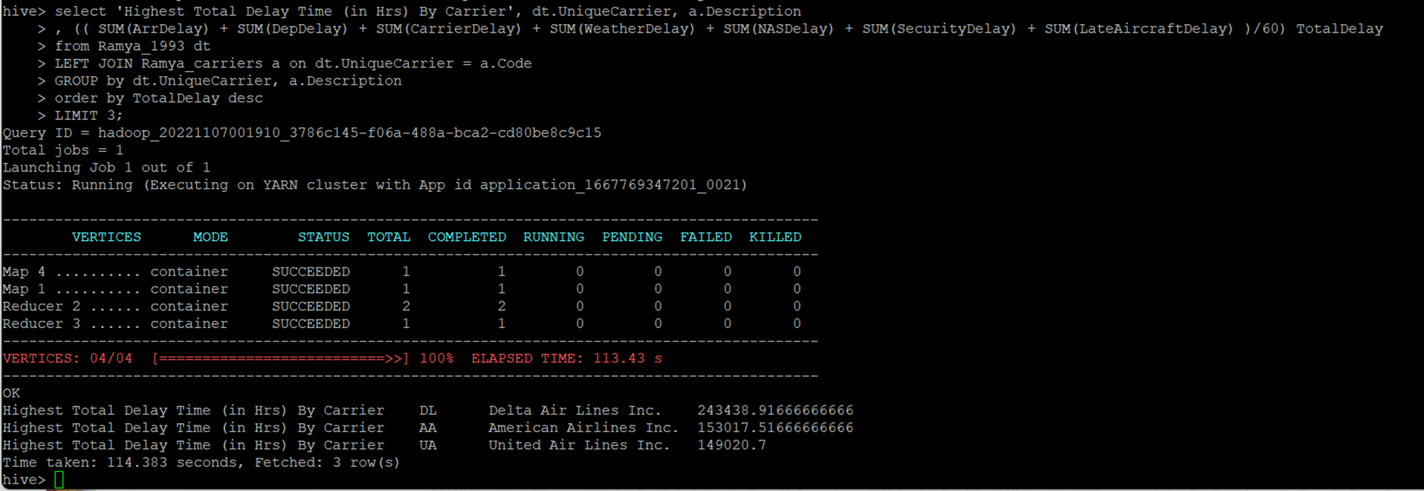
CASE 2
Determine the three carriers with the highest delay time (in hours)
Ramya Dhabade - Year 1993

Slide 29
CASE 2: RESULT
The top three carriers with the highest delay time (in hours)
Year | Carrier Name | Arrival Time Delay (in hours) | Departure Time Delay (in hours) | Total Delay (in hours)
1993 | Delta Air Lines Inc. | 127,965 | 115,473 | 243,438
1993 | American Airlines Inc. | 78,598 | 74,419 | 153,017
1993 | United Air Lines Inc. | 72,547 | 76,473 | 149,020
Ramya Dhabade - Year 1993

Slide 30
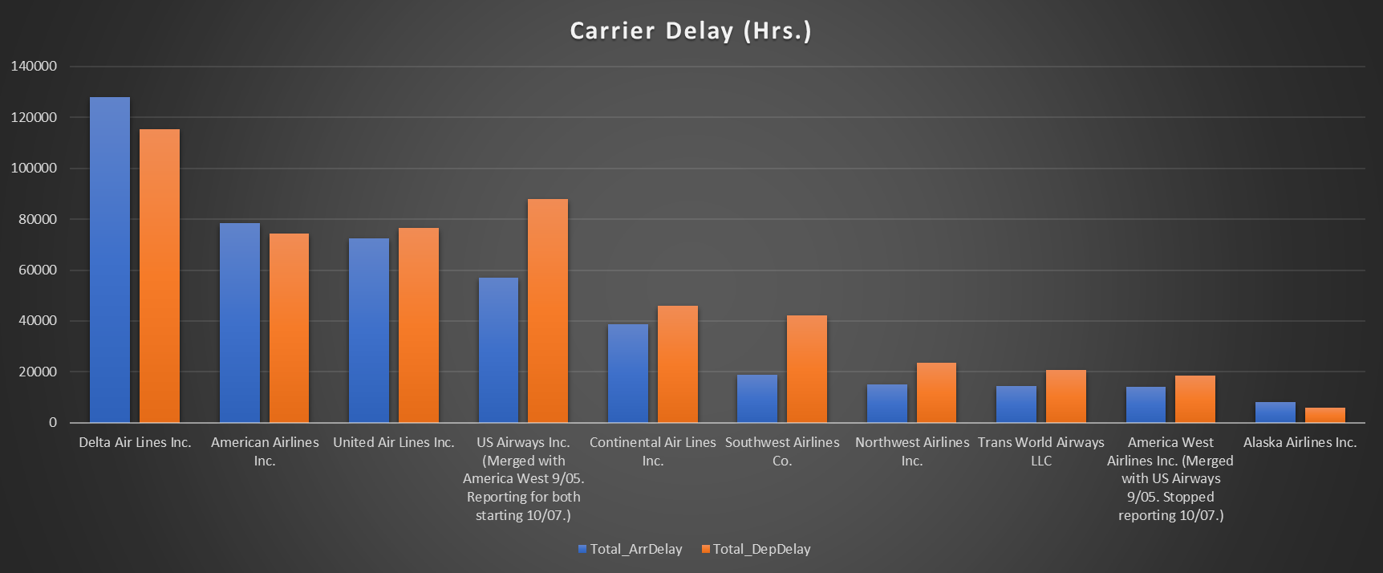
Overall Carrier Delay Metrics
Ramya Dhabade - Year 1993

Slide 31
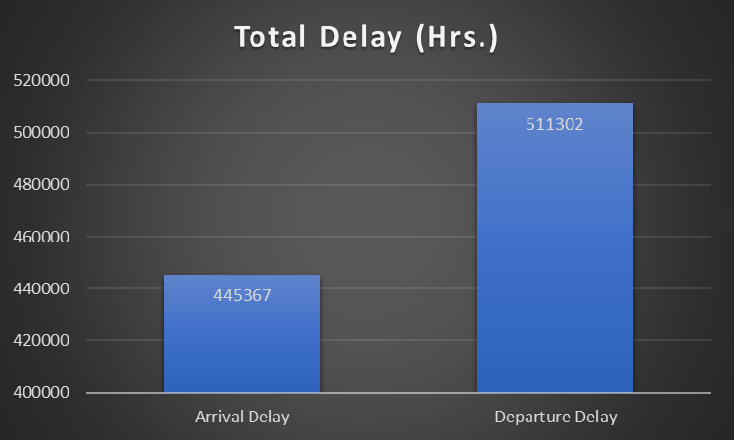
CASE 3: RESULT
Determine overall which type of delay (arrivals or departures) is the largest for airports
Ramya Dhabade - Year 1993

Slide 32

Krina Gandhi

Slide 33
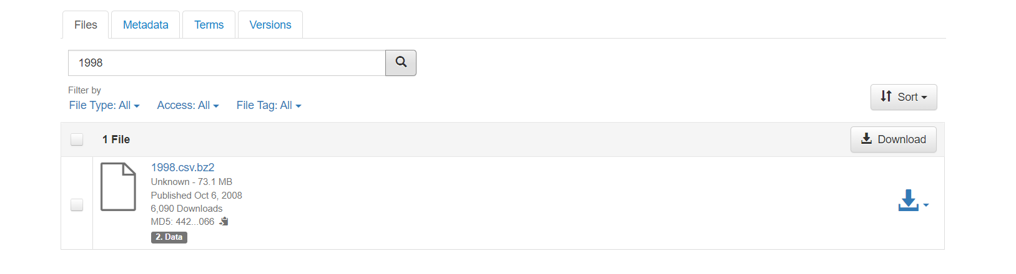
Retrieving the Data : Airlines (Year 1998)
Downloading csv file from the link:

Slide 34
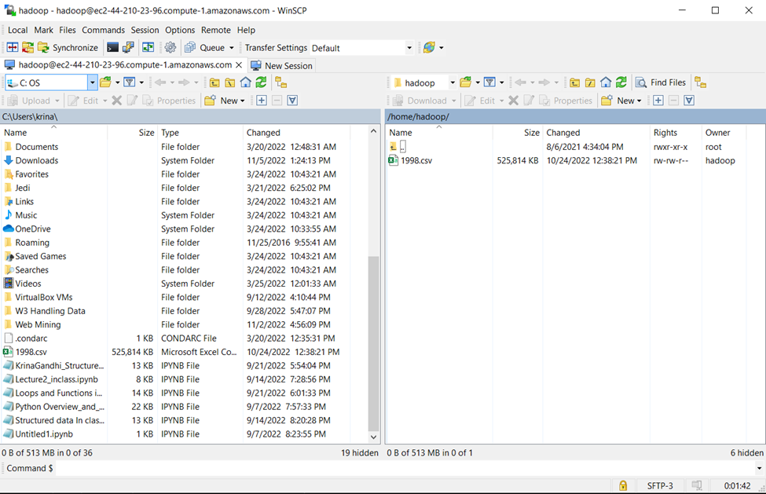
Transferring the Data : Airlines (Year 1998)

Slide 35
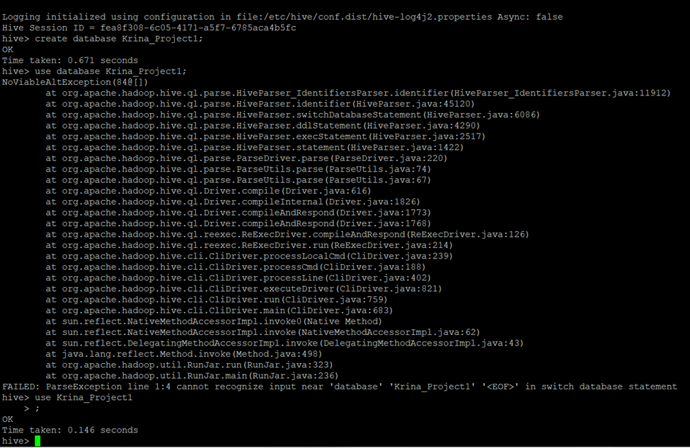
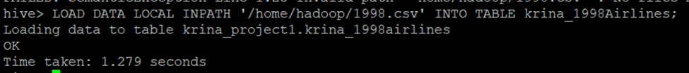
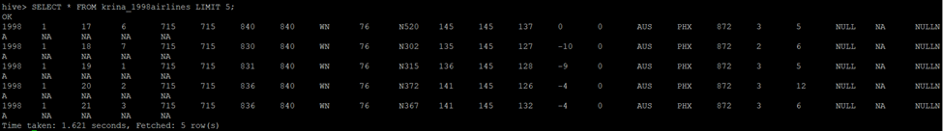
Airlines : Table Creation, Data Load & Samples

Slide 36
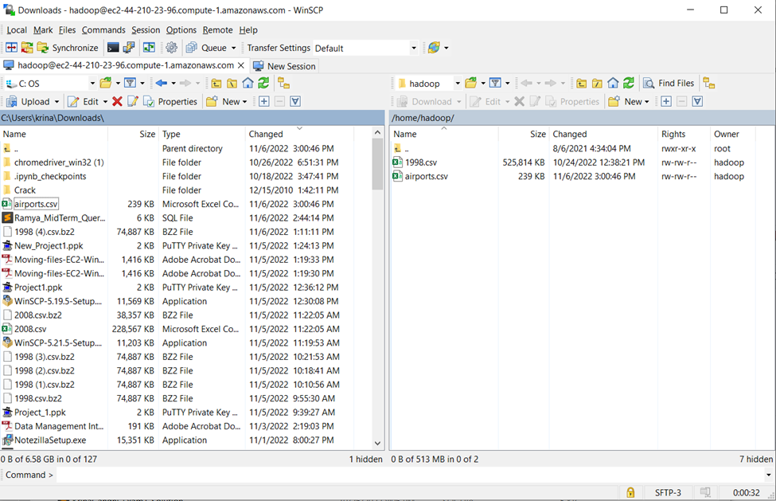
Transferring the Data : Airports

Slide 37
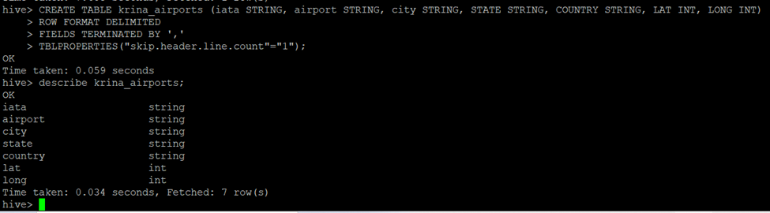
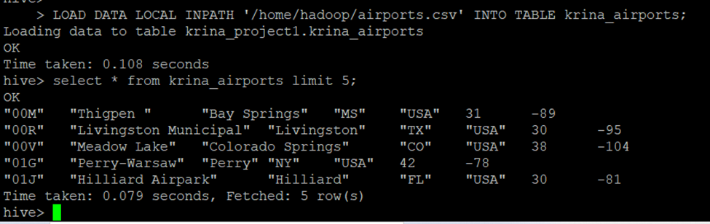
Airports: Table Creation, Data Load & Samples

Slide 38
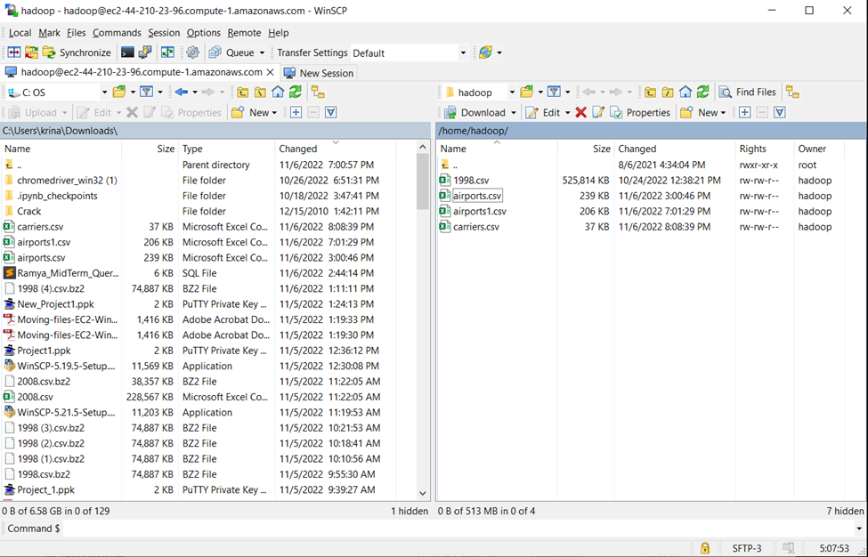
Transferring the Data : Carriers

Slide 39
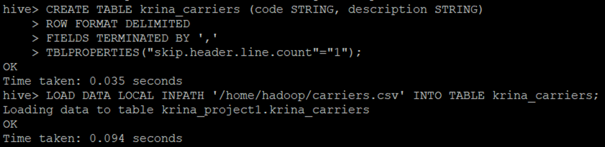
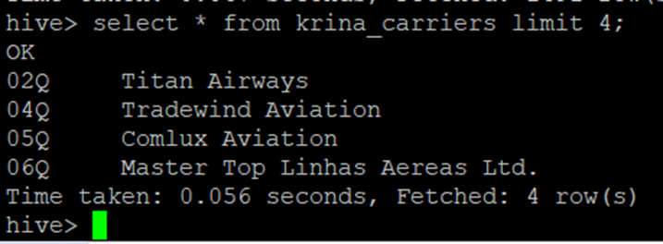
Carriers: Table Creation, Data Load & Samples

Slide 40
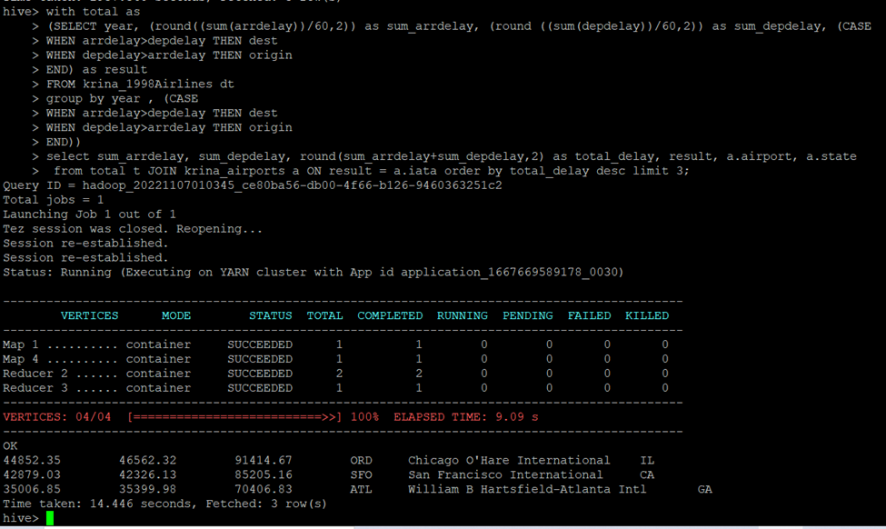
CASE 1: Determining three airports with the highest delay time (in hours)

Slide 41
CASE 1: RESULT
The three airports with the highest delay time (in hours)
Year | Airport Name | Arrival Time Delay (in hours) | Departure Time Delay (in hours) | Total Delay (in hours)
1998 | Chicago O’hare International | 44,852.35 | 46,562.32 | 91,414.67
1998 | San Francisco International | 42,879.03 | 42,326.13 | 85,205.16
1998 | William B Hartsfield-Atlanta International | 35,006.85 | 35,399.98 | 70,406.83

Slide 42
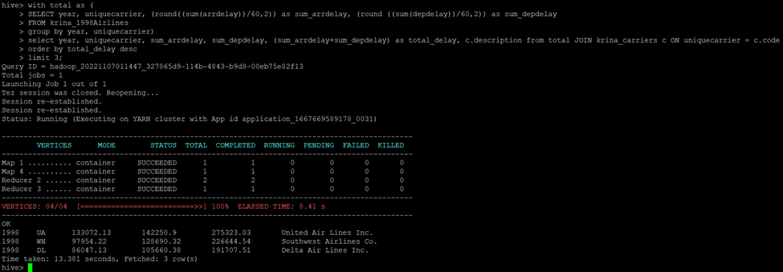
CASE 2: Determining three carriers with the highest delay time (in hours)

Slide 43
CASE 2: RESULT
The three carriers with the highest delay time (in hours)
Year | Carrier Name | Arrival Time Delay (in hours) | Departure Time Delay (in hours) | Total Delay (in hours)
1998 | United Air Lines Inc. | 133,072.13 | 142,250.9 | 275,323.03
1998 | Southwest Airlines Inc. | 97,954.22 | 128,690.32 | 226,644.54
1998 | Delta Airlines Inc. | 86,047.13 | 105,660.38 | 191,707.51

Slide 44
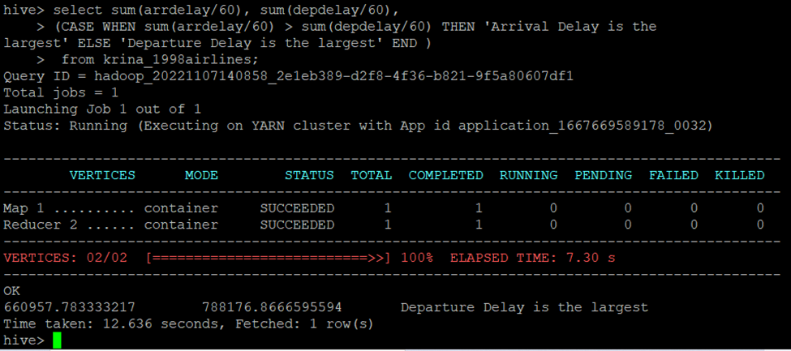
CASE 3: Determining which type of delay is largest overall (in hours)

Slide 45
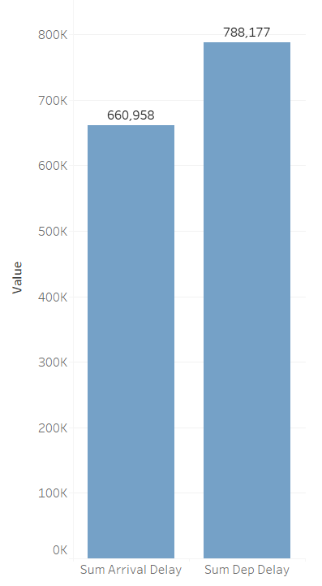
CASE 3: RESULT
Determine overall which type of delay (arrivals or departures) is the largest for airports

Slide 46

Himanshu Hariyani

Slide 47
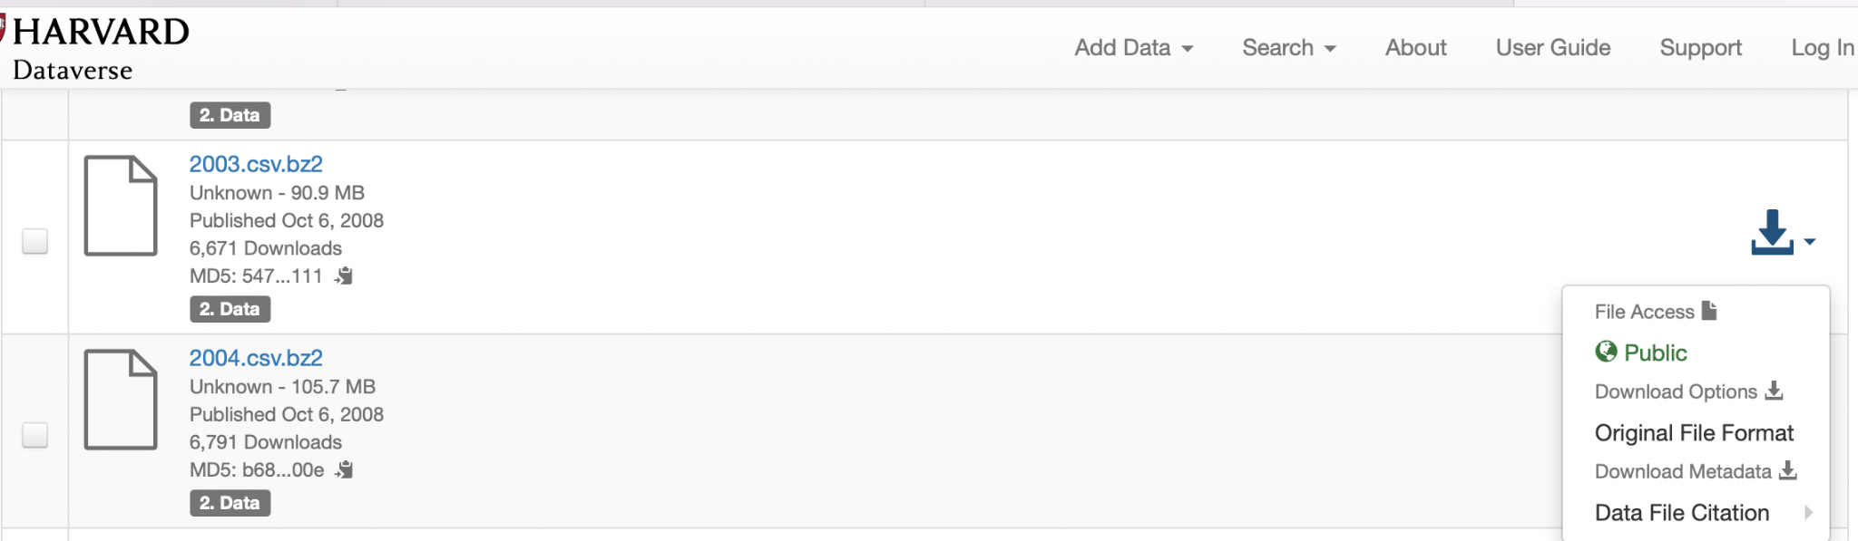
Himanshu Hariyani
The data represents flight arrival and departure details for all commercial flights within the USA for the year 2003
Harvard - Airline On Time Data
Himanshu Hariyani - 2003

Slide 48
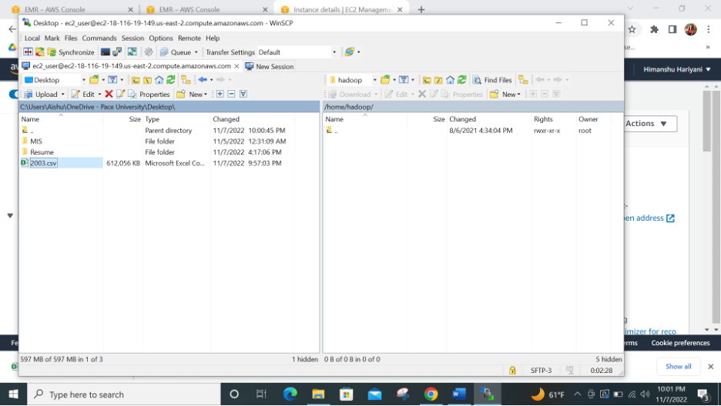
FILE TRANSFER
WINSCP used for upload of file to the EMR server

Slide 49
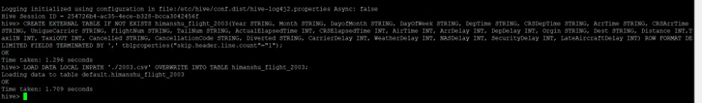
Airline: Data Load
Himanshu Hariyani - 2003

Slide 50
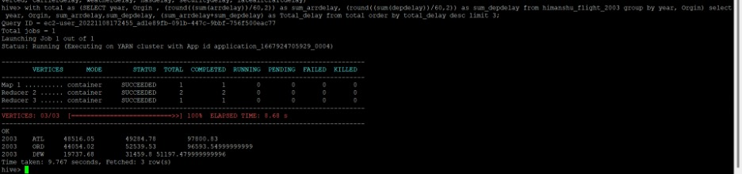
CASE 1
Determining three airports with highest delay time (in hours) for year 2003
Himanshu Hariyani - 2003

Slide 51
CASE 1 : RESULT
Year | Airport Name | Arrival time Delay (in hours) | Departure time Delay (in hours) | Total Delay (in hours)
2003 | Atlanta International | 48516.05 | 49284.78 | 97800.83
2003 | O’Hare International | 44054.02 | 52539.53 | 96593.54
2003 | Dales/Fort International | 19737.68 | 31459.8 | 51197.47
Himanshu Hariyani - 2003

Slide 52
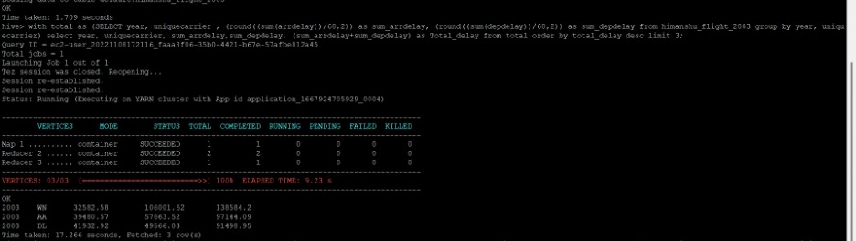
CASE 2
Determining three carriers with highest delay time (in hours) for year 2003
Himanshu Hariyani - 2003

Slide 53
CASE 2 : RESULT
Year | Airline | Arrival time Delay (in hours) | Departure time Delay (in hours) | Total Delay (in hours)
2003 | SouthWest Airlines | 32582.58 | 106001.62 | 138584.2
2003 | American Airlines | 39480.57 | 57663.52 | 97144.09
2003 | Delta Airlines | 41932.92 | 49566.03 | 91498.95
Himanshu Hariyani - 2003

Slide 54
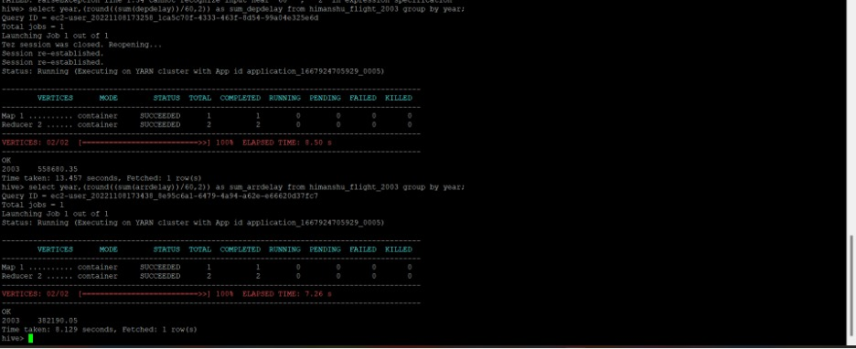
CASE 3
Overall departure delays

Slide 55
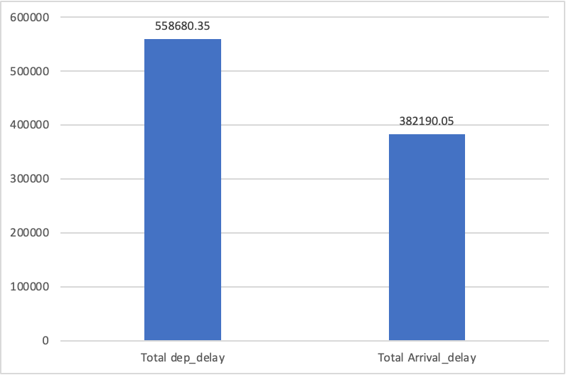
CASE 3
Overall Arrival was the smallest contributor for the year 2003

Slide 56

Shubham Kadam

Slide 57
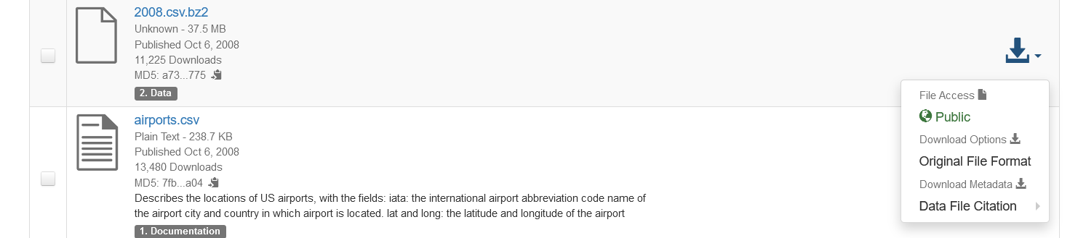
Shubham Kadam
Data source
Airline On Time Data
The data represents flight arrival and departure details for all commercial flights within the USA for the year 2008
Download Link
Harvard - Airline On Time Data
Shubham kadam Year -2008

Slide 58
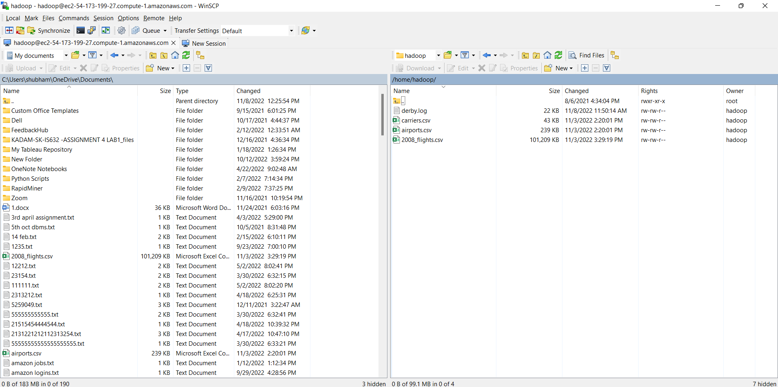
Retrieved data from local to hdfs directory
Shubham kadam Year -2008

Slide 59
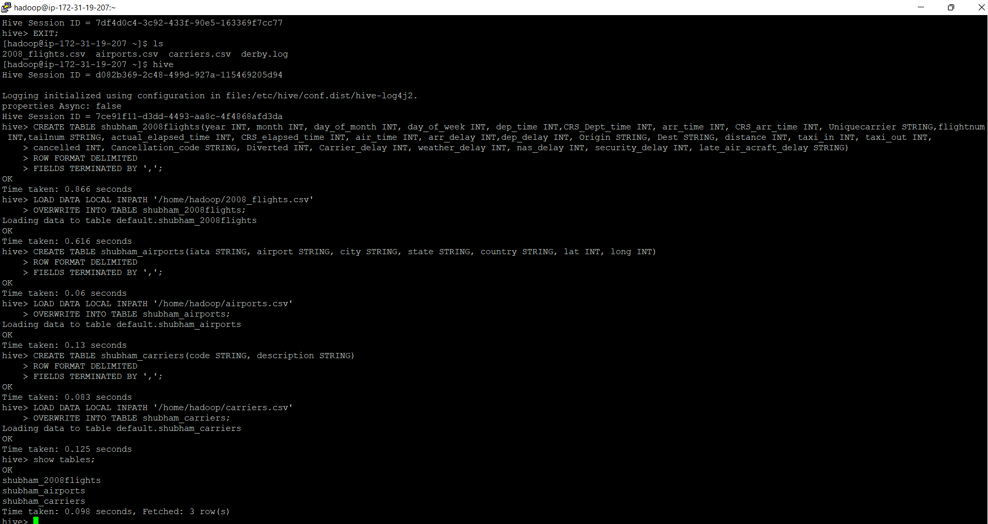
Tables and database
Shubham kadam Year -2008

Slide 60
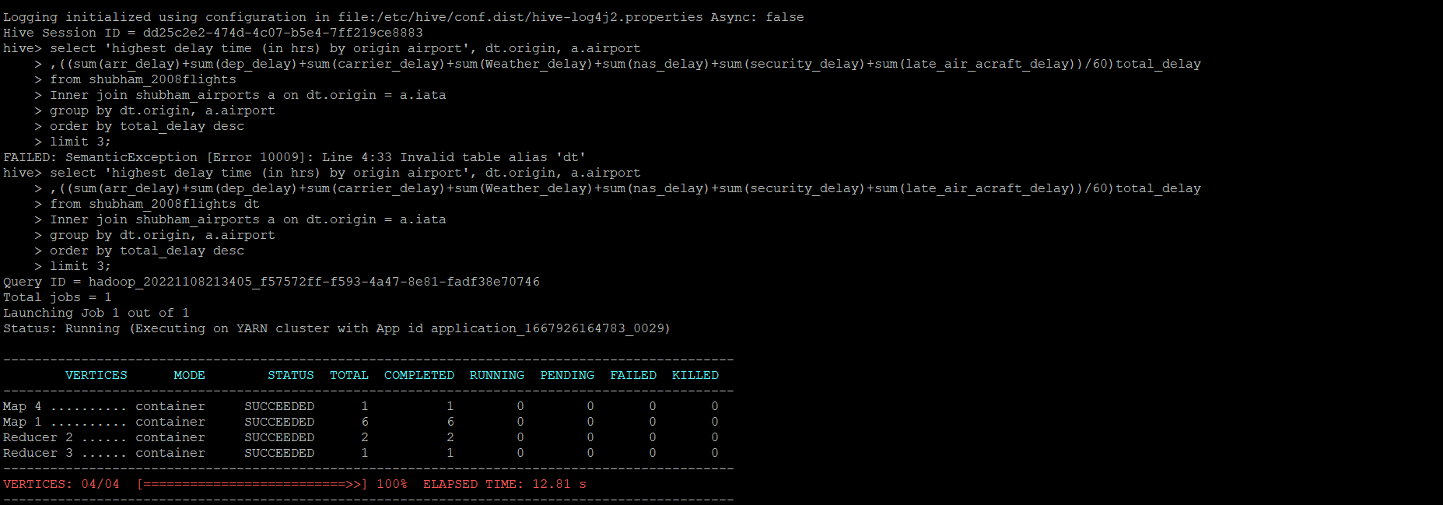
Case 1 queries
Shubham kadam Year -2008

Slide 61
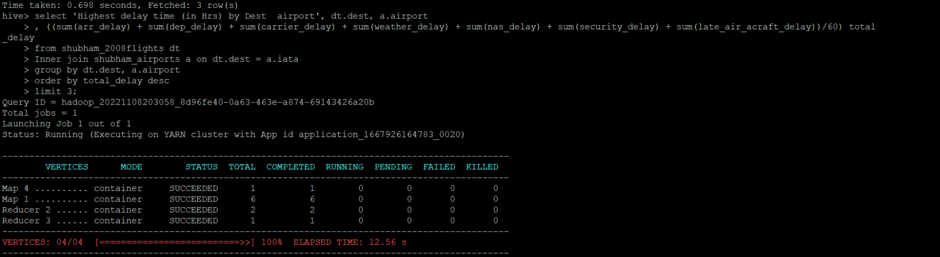
Shubham kadam Year -2008

Slide 62
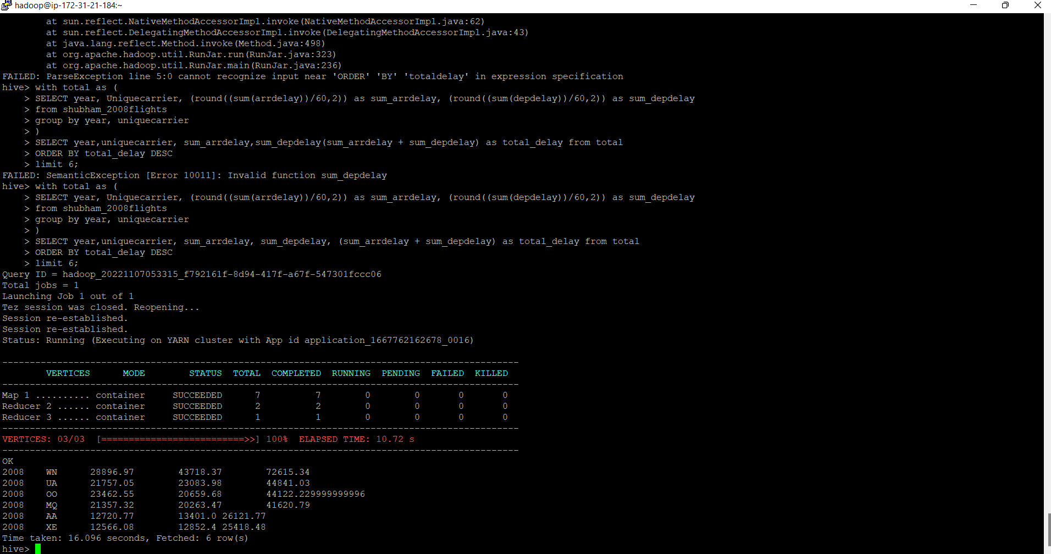
The three airports with the highest delay time (in hours) for year 2008
(Displayed in hours) Results

Slide 63
CASE 1: RESULT
Shubham kadam Year -2008
The three airports with the highest delay time (in hours)
Year | Origin | Airport Name | Arrival Time Delay (in hours) | Departure Time Delay (in hours) | Total Delay (in hours)
2008 | WNA | Napakiak Airport | 28896.97 | 43718.37 | 72615.34
2008 | DUA | Durant Regional Airport | 21757.05 | 23083.98 | 44841.03
2008 | OOO | Plumas County Nervino Airport | 23462.55 | 20659.68 | 44122.22

Slide 64
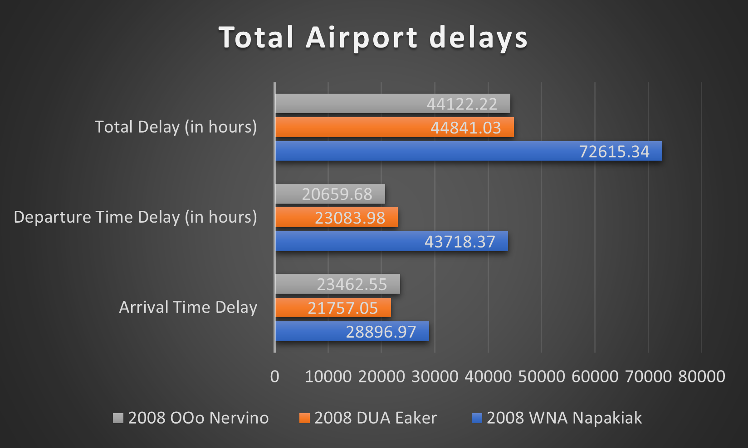
CASE 1 (contd..)
Airports with the highest delay time (in hours)
Shubham kadam Year -2008

Slide 65

CASE 2
Determine the three carriers with the highest delay time (in hours)
Shubham kadam Year -2008

Slide 66
CASE 2: RESULT
Shubham kadam Year -2008
Top 3 carriers with Highest Delays for the year 2008 (in hours)
Year | Carrier Name | Arrival Time Delay (in hours) | Departure Time Delay (in hours) | Total Delay (in hours)
2008 | Skywest Airlines Inc. | 3031.5 | 5032.43 | 8063.933
2008 | Southwest Airlines Co. | 4623.89 | 2623.89 | 7247.78
2008 | Atlantic Southeast Airlines | 3633.55 | 2328.56 | 6265.11

Slide 67

CASE 2 (contd..)
three carriers with the highest delay time (in hours)
for 2008
Shubham kadam Year -2008

Slide 68

CASE 3
Overall Departure Delays for 2008
Shubham kadam Year -2008

Slide 69

Overall delay (arrivals or departures) for airports
Shubham kadam Year -2008

Slide 70

Summary:
3
Carriers with highest delay:

Slide 71

Airports with highest delay:

Slide 72

Arrival and Departure delay across years:

Slide 73
Conclusion:
Departure Delay is highest in all the years.

Slide 74
Thank You!

